Slide 1
Black Hole Astrophysics Chapter 7.4
All figures extracted from online sources of from the textbook.

Slide 2
Flowchart
Basic properties of the Schwarzschild metric
Coordinate systems
Equation of motion and conserved quantities
Let’s throw stuff in!
What does it feel like to orbit a Black Hole?
General motion in Schwarzschild Metric
Horizon Penetrating coordinates

Slide 3
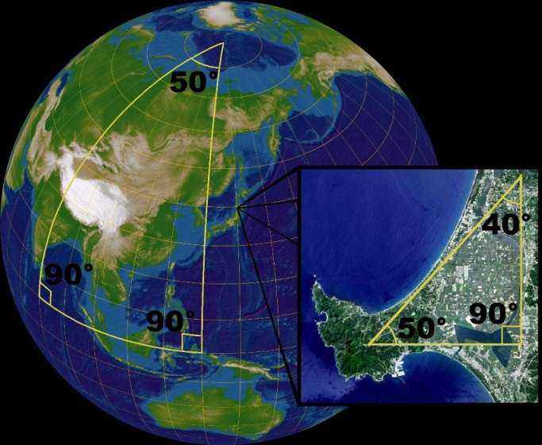
The Schwarzschild Matric
“Sch” means that this metric is describing a Schwarzschild Black Hole.
$${\left(g_{SH}^{Sch}\right)}_{αβ}=\left(\begin{matrix}−c^{2}⁢\left(1−\frac{r_{s}}{r}\right) & 0 & 0 & 0 \\ 0 & \frac{1}{\left(1−\frac{r_{s}}{r}\right)} & 0 & 0 \\ 0 & 0 & r^{2} & 0 \\ 0 & 0 & 0 & r^{2}⁢\sin^{2}⁢θ\end{matrix}\right)$$
Recall: A Schwarzschild Black Hole is a solution of the Einstein Equations assuming that we put a point mass M in free space and then assume that we are in a static coordinate.
The Schwarzschild radius $r_{s}=\frac{2⁢GM}{c^{2}}$
“SH” means that we are in the Schwarzschild-Hilbert coordinate system.
Why bother?
Remember that we are now in curved space, but we can sometimes for convenience still choose a locally flat coordinate to consider the physics. The SH coordinate is just like considering the whole surface of the Earth as a curved surface.
The metric being diagonal also says that relativistic spherical gravity is still a radial r=force.

Slide 4
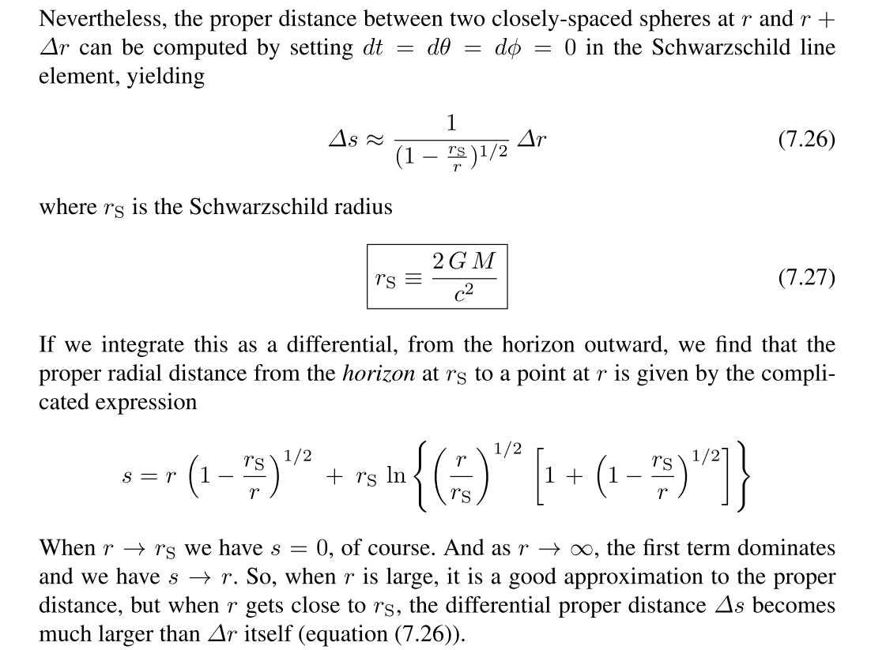
Some basic properties
$$ds≈\frac{dr}{\sqrt{1−\frac{r_{s}}{r}}}$$
$$\left.Integrate[\frac{1}{\sqrt{1−\frac{r_{s}}{r0}}},\left\{r0,r_{s},r\right\}]\right]$$
$$s=r⁢\sqrt{r⁢\left(1−\frac{r_{s}}{r}\right)}+r_{s}⁢\left.Log[\sqrt{\frac{r}{r_{s}}}⁢\left(1+\sqrt{1−\frac{r_{s}}{r}}\right)\right]$$
When $r→r_{s},s→0$
$r→∞,s→r$ and it reduces to Newtonian gravity as expected

Slide 5
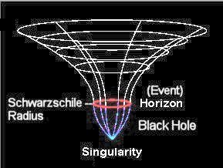
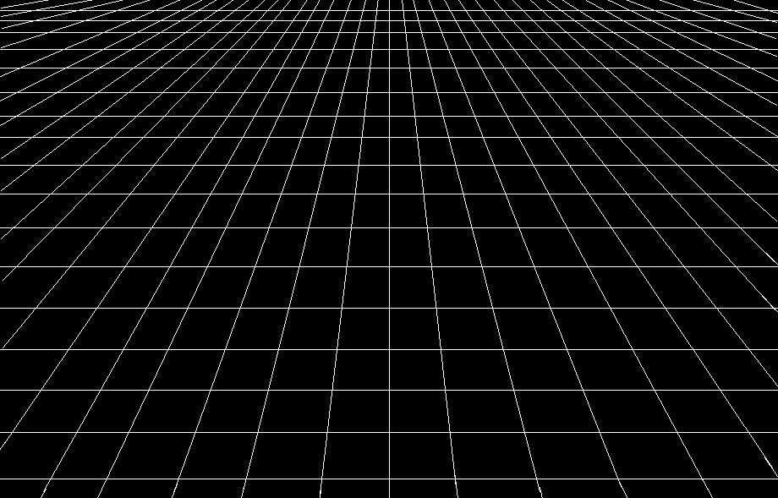
Limits at infinity
$${\left(g_{SH}^{Sch}\right)}_{αβ}=\left(\begin{matrix}−c^{2}⁢\left(1−\frac{r_{s}}{r}\right) & 0 & 0 & 0 \\ 0 & \frac{1}{\left(1−\frac{r_{s}}{r}\right)} & 0 & 0 \\ 0 & 0 & r^{2} & 0 \\ 0 & 0 & 0 & r^{2}⁢\sin^{2}⁢θ\end{matrix}\right)→\left(\begin{matrix}−c^{2} & 0 & 0 & 0 \\ 0 & 1 & 0 & 0 \\ 0 & 0 & r^{2} & 0 \\ 0 & 0 & 0 & r^{2}⁢\sin^{2}⁢θ\end{matrix}\right)$$
If we take $r→∞$ or $r_{s}→0 (i.e. M→0)$
Reduces to the Minkowski metric!

Slide 6
Passing the horizon
Outside the horizon $r>r_{s}$
Inside the horizon $r<r_{s}$
$$\left(\begin{matrix}−c^{2}⁢\left(1−\frac{r_{s}}{r}\right) & 0 & 0 & 0 \\ 0 & \frac{1}{\left(1−\frac{r_{s}}{r}\right)} & 0 & 0 \\ 0 & 0 & r^{2} & 0 \\ 0 & 0 & 0 & r^{2}⁢\sin^{2}⁢θ\end{matrix}\right)→\left(\begin{matrix}c^{2}⁢\left(\frac{r_{s}}{r}−1\right) & 0 & 0 & 0 \\ 0 & −\frac{1}{\left(\frac{r_{s}}{r}−1\right)} & 0 & 0 \\ 0 & 0 & r^{2} & 0 \\ 0 & 0 & 0 & r^{2}⁢\sin^{2}⁢θ\end{matrix}\right)$$
What’s so interesting?
We know that particles can only travel on timelike trajectories, that is, ${ds}^{2}<0$.
Outside the horizon, $g_{tt}$ is the negative term so we can be on a timelike trajectory if we have $dt≠0,dr=dθ=dϕ=0$
Inside the horizon, it is $g_{rr}$ that is negative! So to be on a timelike trajectory, the simplest case would be to have $dr≠0,dt=dθ=dϕ=0$
This means that we can only fall toward the BH once we pass the horizon!

Slide 7
Coordinate Systems
1. The moving body frame (MOV)
3. Schwarzschild-Hilbert frame (SH)
2. Fixed local Lorentz frame (FIX)

Slide 8
The moving body frame (MOV)
In this frame, we are moving with the object of interest. Since spacetime is locally flat, we have a Minkowski metric in this case
$${\left(g_{MOV}^{Sch}\right)}_{αβ}=\left(\begin{matrix}−1 & 0 & 0 & 0 \\ 0 & 1 & 0 & 0 \\ 0 & 0 & 1 & 0 \\ 0 & 0 & 0 & 1\end{matrix}\right)$$
and by definition the 4-velocity ${\left(U_{MOV}\right)}^{α}=\left(c,0,0,0\right)$
This frame is useful for expressing microphysics, such as gas pressure, temperature, and density, but not motion.

Slide 9
Fixed local Lorentz frame (FIX)
In this frame, we consider some locally flat part of the Schwarzschild spacetime to sit on and watch things fly past. Therefore the metric is still the Minkowski one
$${\left(g_{FIX}^{Sch}\right)}_{αβ}=\left(\begin{matrix}−1 & 0 & 0 & 0 \\ 0 & 1 & 0 & 0 \\ 0 & 0 & 1 & 0 \\ 0 & 0 & 0 & 1\end{matrix}\right)$$
but now the 4-velocity of objects become
$${\left(U_{FIX}\right)}^{α}=\left(\begin{matrix}γc \\ {γV}^{\hat{r}} \\ {γV}^{\hat{θ}} \\ {γV}^{\hat{φ}}\end{matrix}\right)$$
which is obvious since the FIX and MOV frames are simply related by a Lorentz Transform.
It is a convenient frame for looking at motion of particles.
However, it is not unique, there is a different FIX frame for every point around the black hole. This also means that time flows differently in different frames.

Slide 10
Schwarzschild-Hilbert frame (SH)
This is a global coordinate, so it does not have the problems in the FIX frame, there is a unique time coordinate and a single $\left(r,θ,φ\right)$ system.
For this coordinate, the metric is the one we presented earlier
$${\left(g_{SH}^{Sch}\right)}_{αβ}=\left(\begin{matrix}−c^{2}⁢\left(1−\frac{r_{s}}{r}\right) & 0 & 0 & 0 \\ 0 & \frac{1}{\left(1−\frac{r_{s}}{r}\right)} & 0 & 0 \\ 0 & 0 & r^{2} & 0 \\ 0 & 0 & 0 & r^{2}⁢\sin^{2}⁢θ\end{matrix}\right)$$
However, in such a case
$${\left(U_{SH}\right)}^{α}=\left(\begin{matrix}U^{t} \\ U^{r} \\ U^{θ} \\ U^{φ}\end{matrix}\right)$$
is hard to interpret.

Slide 11
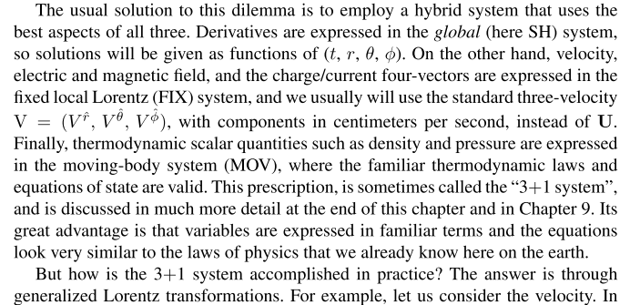
Which frame to use?

Slide 12
How to go from FIX to SH frame?
$$g_{α′⁢β′}={Λ_{α′}}^{α}⁢{Λ_{β′}}^{β}⁢g_{αβ}$$
$${\left(g_{SH}^{Sch}\right)}_{αβ}$$
$$=\left(\begin{matrix}−c^{2}⁢\left(1−\frac{r_{s}}{r}\right) & 0 & 0 & 0 \\ 0 & \frac{1}{\left(1−\frac{r_{s}}{r}\right)} & 0 & 0 \\ 0 & 0 & r^{2} & 0 \\ 0 & 0 & 0 & r^{2}⁢\sin^{2}⁢θ\end{matrix}\right)$$
$$≡\left(\begin{matrix}g_{tt} & 0 & 0 & 0 \\ 0 & g_{rr} & 0 & 0 \\ 0 & 0 & g_{θθ} & 0 \\ 0 & 0 & 0 & g_{ϕϕ}\end{matrix}\right)$$
$${\left(g_{SH}^{Sch}\right)}_{α′⁢β′}={Λ_{SH(α′⁢)}}^{⁢FIX(α)}⁢{Λ_{⁢SH(β′)}}^{FIX(β)}⁢{\left(g_{FIX}^{Sch}\right)}_{αβ}$$
$$\left(\begin{matrix}g_{tt} & 0 & 0 & 0 \\ 0 & g_{rr} & 0 & 0 \\ 0 & 0 & g_{θθ} & 0 \\ 0 & 0 & 0 & g_{ϕϕ}\end{matrix}\right)={Λ_{SH⁢\left(α′\right)}}^{FIX⁢\left(α\right)}⁢{Λ_{SH⁢\left(β′\right)}}^{FIX⁢\left(β\right)}⁢\left(\begin{matrix}−1 & 0 & 0 & 0 \\ 0 & 1 & 0 & 0 \\ 0 & 0 & 1 & 0 \\ 0 & 0 & 0 & 1\end{matrix}\right)$$
Generalized Lorentz Transform
$${Λ_{SH}}^{FIX}=\left(\begin{matrix}\sqrt{−g_{tt}} & 0 & 0 & 0 \\ 0 & \sqrt{g_{rr}} & 0 & 0 \\ 0 & 0 & \sqrt{g_{θθ}} & 0 \\ 0 & 0 & 0 & \sqrt{g_{ϕϕ}}\end{matrix}\right)=\left(\begin{matrix}c⁢\sqrt{1−\frac{r_{s}}{r}} & 0 & 0 & 0 \\ 0 & \frac{1}{\sqrt{1−\frac{r_{s}}{r}}} & 0 & 0 \\ 0 & 0 & r & 0 \\ 0 & 0 & 0 & r⁢sinθ\end{matrix}\right)$$
$${\left(g_{FIX}^{Sch}\right)}_{αβ}=\left(\begin{matrix}−1 & 0 & 0 & 0 \\ 0 & 1 & 0 & 0 \\ 0 & 0 & 1 & 0 \\ 0 & 0 & 0 & 1\end{matrix}\right)$$
$${Λ_{FIX}}^{SH}=\left(\begin{matrix}\frac{1}{\sqrt{−g_{tt}}} & 0 & 0 & 0 \\ 0 & \frac{1}{\sqrt{g_{rr}}} & 0 & 0 \\ 0 & 0 & \frac{1}{\sqrt{g_{θθ}}} & 0 \\ 0 & 0 & 0 & \frac{1}{\sqrt{g_{ϕϕ}}}\end{matrix}\right)=\left(\begin{matrix}\frac{1}{c⁢\sqrt{1−\frac{r_{s}}{r}}} & 0 & 0 & 0 \\ 0 & \sqrt{1−\frac{r_{s}}{r}} & 0 & 0 \\ 0 & 0 & \frac{1}{r} & 0 \\ 0 & 0 & 0 & \frac{1}{r⁢sinθ}\end{matrix}\right)$$

Slide 13
Expressing the 4-velocity in SH coordinates
$${\left(U_{FIX}\right)}^{α}=\left(\begin{matrix}γc \\ {γV}^{\hat{r}} \\ {γV}^{\hat{θ}} \\ {γV}^{\hat{φ}}\end{matrix}\right)$$
$${Λ_{FIX}}^{SH}=\left(\begin{matrix}\frac{1}{\sqrt{−g_{tt}}} & 0 & 0 & 0 \\ 0 & \frac{1}{\sqrt{g_{rr}}} & 0 & 0 \\ 0 & 0 & \frac{1}{\sqrt{g_{θθ}}} & 0 \\ 0 & 0 & 0 & \frac{1}{\sqrt{g_{ϕϕ}}}\end{matrix}\right)=\left(\begin{matrix}\frac{1}{c⁢\sqrt{1−\frac{r_{s}}{r}}} & 0 & 0 & 0 \\ 0 & \sqrt{1−\frac{r_{s}}{r}} & 0 & 0 \\ 0 & 0 & \frac{1}{r} & 0 \\ 0 & 0 & 0 & \frac{1}{r⁢sinθ}\end{matrix}\right)$$
$${\left(U_{SH}\right)}^{α}=\left(\begin{matrix}U^{t} \\ U^{r} \\ U^{θ} \\ U^{φ}\end{matrix}\right)$$
$${\left(U_{SH}\right)}^{α′}=\left(\begin{matrix}U^{t} \\ U^{r} \\ U^{θ} \\ U^{φ}\end{matrix}\right)={Λ_{FIX⁢\left(α\right)}}^{SH⁢\left(α′\right)}⁢{\left(U_{FIX}\right)}^{α}=\left(\begin{matrix}\frac{1}{c⁢\sqrt{1−\frac{r_{s}}{r}}} & 0 & 0 & 0 \\ 0 & \sqrt{1−\frac{r_{s}}{r}} & 0 & 0 \\ 0 & 0 & \frac{1}{r} & 0 \\ 0 & 0 & 0 & \frac{1}{r⁢sinθ}\end{matrix}\right)⁢\left(\begin{matrix}γc \\ {γV}^{\hat{r}} \\ {γV}^{\hat{θ}} \\ {γV}^{\hat{φ}}\end{matrix}\right)=\left(\begin{matrix}\frac{γ}{\sqrt{1−\frac{r_{s}}{r}}} \\ \sqrt{1−\frac{r_{s}}{r}}⁢{γV}^{\hat{r}} \\ \frac{{γV}^{\hat{θ}}}{r} \\ \frac{{γV}^{\hat{φ}}}{r⁢sinθ}\end{matrix}\right)$$
This now becomes more convenient to use and interpret. ${U_{SH}}^{α}$ is the 4-velocity of the global frame and we write its components in terms of local frame parameters $\left(V^{\hat{r}},V^{\hat{θ}},V^{\hat{φ}}\right)$

Slide 14
Let’s examine the 4-velocity
$${U_{SH}}^{α}=\left(\begin{matrix}\frac{γ}{\sqrt{1−\frac{r_{s}}{r}}} \\ \sqrt{1−\frac{r_{s}}{r}}⁢{γV}^{\hat{r}} \\ \frac{{γV}^{\hat{θ}}}{r} \\ \frac{{γV}^{\hat{φ}}}{r⁢sinθ}\end{matrix}\right)=\left(\begin{matrix}\frac{dt}{dτ} \\ \frac{dr}{dτ} \\ \frac{dθ}{dτ} \\ \frac{dϕ}{dτ}\end{matrix}\right)$$
We expect from our old idea of gravity that the velocity of objects should approach c as we get to the black hole, but if we check
$${\left(\frac{dr}{dt}\right)}_{SH}=\frac{dr}{dτ}⁢\frac{dτ}{dt}=\frac{{U_{SH}}^{r}}{{U_{SH}}^{t}}=\left(1−\frac{r_{s}}{r}\right)⁢V^{\hat{r}}$$
Then when $r→r_{s}$ ${\left(\frac{dr}{dt}\right)}_{SH}→0$ ！
Particles seen in the SH frame apparently are ‘stuck’ at the horizon and never get across it!
But particles should fall into black holes!
This is simply due to the Generalized Lorentz Transform.

Slide 15
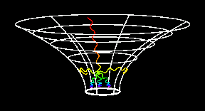
What happened?
$${\left({Λ_{FIX}}^{SH}\right)}_{diag}=\left(\frac{1}{c⁢\sqrt{1−\frac{r_{s}}{r}}},\sqrt{1−\frac{r_{s}}{r}},\frac{1}{r},\frac{1}{r⁢sinθ}\right)$$
$${dt}_{SH}=\frac{{dt}_{FIX}}{\sqrt{1−\frac{r_{s}}{r}}}$$
Consider someone falling into a black hole, the local FIX frame observes the time of the person as ${dt}_{FIX}$, then, for a person sitting watching the BH very far away he would observe ${dt}_{SH}$.
Given that ${dt}_{FIX}$ should be finite, as $r→r_{s}$, ${dt}_{SH}→∞$
It would take the far away observer infinite amount of time to watch the unfortunate person falling into the hole!
This also says that any photon sent out by the falling person would be infinitely redshifted.

Slide 16
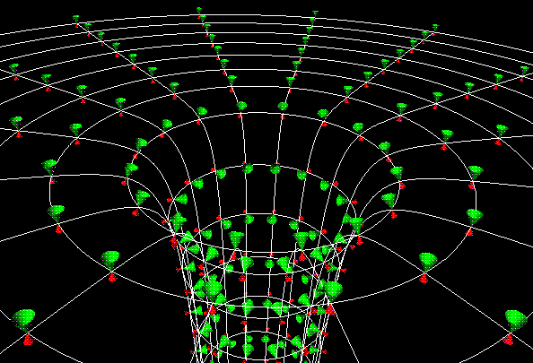
What happened?
$${\left({Λ_{FIX}}^{SH}\right)}_{diag}=\left(\frac{1}{c⁢\sqrt{1−\frac{r_{s}}{r}}},\sqrt{1−\frac{r_{s}}{r}},\frac{1}{r},\frac{1}{r⁢sinθ}\right)$$
$${dr}_{SH}={dr}_{FIX}⁢\sqrt{1−\frac{r_{s}}{r}}$$
Similarly, for finite ${dr}_{FIX}$, as $r→r_{s}$, ${dr}_{SH}→0$！
No matter how much the person moves in some instant, a far away observer would observe him as stuck!
In the FIX frame
In the SH frame
Ahhhhh
Ah
…h
…….h
………….
Therefore combining ${dt}_{SH}=\frac{{dt}_{FIX}}{\sqrt{1−\frac{r_{s}}{r}}}$ and ${dr}_{SH}={dr}_{FIX}⁢\sqrt{1−\frac{r_{s}}{r}}$ it’s obvious that the apparent velocity for an observer at infinity is zero！

Slide 17
The Equation of motion
The equation of motion: ${\left(\frac{d⁢\overset{⇀}{P}}{dτ}\right)}^{α}={\left[\left(\overset{⇀}{U}·\overset{⇀}{∇}\right)⁢\overset{⇀}{P}\right]}^{α}=U^{β}⁢\left(\frac{∂P^{α}}{∂β}+{Γ^{α}}_{μβ}⁢P^{μ}\right)=F^{α}$
In general , the equation of motion expands to
$$F^{r}=U^{t}⁢\left(\frac{∂P^{r}}{∂t}+{Γ^{r}}_{μt}⁢P^{μ}\right)+U^{r}⁢\left(\frac{∂P^{r}}{∂r}+{Γ^{r}}_{μr}⁢P^{μ}\right)+U^{θ}⁢\left(\frac{∂P^{r}}{∂θ}+{Γ^{r}}_{μθ}⁢P^{μ}\right)+U^{φ}⁢\left(\frac{∂P^{r}}{∂φ}+{Γ^{r}}_{μϕ}⁢P^{μ}\right)$$
Considering only radial motion, $U^{θ}=U^{φ}=0$ and applying the relation between Christoffel symbols and the metric (we are now working in the SH coordinate),
$$U^{t}⁢\left(\frac{∂P^{r}}{∂t}−\frac{1}{2}⁢g^{rr}⁢\frac{∂g_{tt}}{∂r}P^{t}\right)+U^{r}⁢\left(\frac{∂P^{r}}{∂r}+\frac{1}{2}⁢g^{rr}⁢\frac{∂g_{rr}}{∂r}P^{r}\right)=0$$

Slide 18
Hello Gravity！
$${U^{t}}_{SH}⁢\left(\frac{∂{P^{r}}_{SH}}{∂t_{SH}}−\frac{1}{2}⁢{g^{rr}}_{SH}⁢\frac{∂{g_{tt}}^{SH}}{∂r_{SH}}⁢{P^{t}}_{SH}\right)+{U^{r}}_{SH}⁢\left(\frac{∂{P^{r}}_{SH}}{∂r_{SH}}+\frac{1}{2}⁢{g^{rr}}_{SH}⁢\frac{∂{g_{rr}}^{SH}}{∂r_{SH}}⁢{P^{r}}_{SH}\right)=0$$
Now comes the hidden trick used in the book…${P^{r}}_{SH}={Λ^{SH}}_{FIX}⁢{P^{r}}_{FIX}=\frac{{P^{r}}_{FIX}}{\sqrt{g_{rr}}}$
$$\frac{∂{P^{r}}_{SH}}{∂r_{SH}}+\frac{1}{2}⁢{g^{rr}}_{SH}⁢\frac{∂{g_{rr}}^{SH}}{∂r_{SH}}{P^{r}}_{SH}=\frac{1}{\sqrt{g_{rr}}}⁢\frac{∂{P^{r}}_{FIX}}{∂r_{SH}}−\frac{1}{2}⁢\frac{{P^{r}}_{FIX}}{{\left({g_{rr}}^{SH}\right)}^{1.5}}⁢\frac{∂{g_{rr}}^{SH}}{∂r_{SH}}+\left(\frac{1}{2}⁢\frac{1}{{g_{rr}}^{SH}}⁢\frac{∂{g_{rr}}^{SH}}{∂r_{SH}}\right)⁢\left(\frac{{P^{r}}_{FIX}}{\sqrt{g_{rr}}}\right)$$
$${U^{t}}_{SH}⁢\frac{∂{P^{r}}_{FIX}}{∂t_{SH}}+{U^{r}}_{SH}⁢\frac{∂{P^{r}}_{FIX}}{∂r_{SH}}−\frac{{P^{t}}_{SH}⁢{U^{t}}_{SH}}{\sqrt{g_{rr}}}⁢\frac{1}{2}⁢\frac{∂{g_{tt}}^{SH}}{∂r_{SH}}=0$$
Time dilation factor
It’s from the gradient operator!
$$\frac{{{dP}^{r}}_{FIX}}{dτ}=\frac{d⁢\left({γm}_{0}⁢V^{\hat{r}}\right)}{dτ}=−\frac{γ}{\sqrt{1−\frac{rs}{r}}}⁢\left(\frac{G⁢M⁢\left({γm}_{0}\right)}{r^{2}}\right)$$
General Relativistic Term!
Newtonian Gravity with relativistic mass

Slide 19
Conserved Quantities –1-forms are useful！
Henceforth, if unspecified, all the tensor/vector components are written in the SH coordinate
$$\text{Again} \text{the} \text{equation} \text{of} \text{motion} {\left(\frac{d⁢\overset{⇀}{P}}{dτ}\right)}^{α}={\left[\left(\overset{⇀}{U}·\overset{⇀}{∇}\right)⁢\overset{⇀}{P}\right]}^{α}=U^{β}⁢\left(\frac{∂P^{α}}{∂β}+{Γ^{α}}_{μβ}⁢P^{μ}\right)=F^{α}$$
Considering the$φ$ direction,
$$U^{t}⁢\frac{∂P^{φ}}{∂t}+U^{r}⁢\left(\frac{∂P^{φ}}{∂r}+{Γ^{φ}}_{ϕr}⁢P^{φ}\right)+U^{θ}⁢\left(\frac{∂P^{φ}}{∂θ}+{Γ^{φ}}_{ϕθ}⁢P^{φ}\right)+U^{φ}⁢\left(\frac{∂P^{φ}}{∂φ}+{Γ^{φ}}_{rϕ}⁢P^{r}+{Γ^{φ}}_{θϕ}⁢P^{θ}\right)=0$$
Replacing in the definitions of the Christoffel symbols,
$$U^{t}⁢\frac{∂P^{φ}}{∂t}+U^{r}⁢\frac{∂P^{φ}}{∂r}+U^{θ}⁢\frac{∂P^{φ}}{∂θ}+U^{φ}⁢\frac{∂P^{φ}}{∂φ}+U^{r}⁢P^{φ}⁢\frac{2}{r}+U^{φ}⁢P^{θ}⁢\frac{2⁢cosθ}{sinθ}=0$$
Finally, we get, $\frac{d⁢\left(P^{φ}⁢r^{2}⁢\sin^{2}⁢θ\right)}{dτ}=\frac{{dp}_{φ}}{dτ}≡\frac{dL}{dτ}=0$
$$p_{φ}=γ⁢m_{0}⁢V^{\hat{φ}}⁢r⁢sinθ$$
The angular momentum $p_{φ}$ of a particle is conserved along the trajectory!

Slide 20
Conserved Quantities –1-forms are useful！
Similarly, we can also find that for the energy,
$$\frac{dE}{dτ}=0$$
$$E=−p_{t}=\sqrt{1−\frac{r_{s}}{r}}⁢γ⁢m_{0}⁢c^{2}$$
The energy $p_{t}$ of a particle is also conserved along the trajectory!
This constant, E, is sometimes also called energy at infinity because as $r→∞$, this term goes to $⁢γ⁢m_{0}⁢c^{2}$.
However, since it is the same at any radius, we can use it to calculate$γ(r)$ hence the velocity (we will see this on the next slide).
A moving body is bound to the BH if $E<m_{0}⁢c^{2}$ and unbound otherwise.

Slide 21
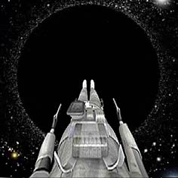
Free fall
On the last slide we mention that we can use E to calculated the Lorentz factor as a function of radial distance r, let’s now work it out.
$$E=−p_{t}=\sqrt{1−\frac{r_{s}}{r}}⁢γ⁢m_{0}⁢c^{2}$$
Consider a particle falling toward a black hole stating from rest at infinity.
This means that $E_{∞}=m_{0}⁢c^{2}=E⁢\left(r\right)=\sqrt{1−\frac{r_{s}}{r}}⁢γ⁢m_{0}⁢c^{2}$
This gives us $γ=\frac{1}{\sqrt{1−{\left({V^{\hat{r}} }/c\right)}^{2}}}$
$$=\frac{1}{\sqrt{1−\frac{rs}{r}}}→{V^{\hat{r}}}_{ff}=−\sqrt{\frac{2⁢G⁢M}{r}}$$
At the event horizon, ${V^{\hat{r}}}_{ff}⁢\left(r_{s}\right)=−c$
We see that if we drop something at infinity and assuming there is noting else in the universe between it and the BH, then it arrives at the BH at exactly the speed of light!

Slide 22
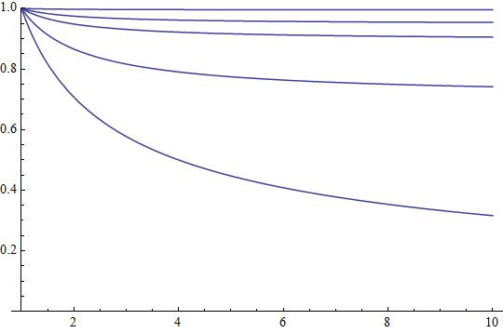
Chucking stuff directly at the BH
Now you might ask：”Particles accelerate to c if we drop them off at infinity, what if we kick them into the BH starting from infinity?”
Special relativity tells us that we can’t exceed c now matter what, so somehow the particle should still end up less than c even if we throw as hard as we can!
Let’s consider a general case in which we don’t specify energy at infinity, thus,
$$E_{∞}=E⁢\left(r\right)=\sqrt{1−\frac{r_{s}}{r}}⁢γ⁢m_{0}⁢c^{2}$$
$$E_{∞}=100m_{0}⁢c^{2}$$
$$E_{∞}=10m_{0}⁢c^{2}$$
$$E_{∞}=5m_{0}⁢c^{2}$$
$$E_{∞}=2m_{0}⁢c^{2}$$
Solving this gives $V^{\hat{r}}=−c⁢\sqrt{1−\left(\frac{m_{0}⁢c^{2}}{E}\right)⁢\left(1−\frac{r_{s}}{r}\right)}$
$$E_{∞}=m_{0}⁢c^{2}$$
Interestingly, no matter what E is, when $r=r_{s}$, we always get $V^{\hat{r}}=−c$！

Slide 23
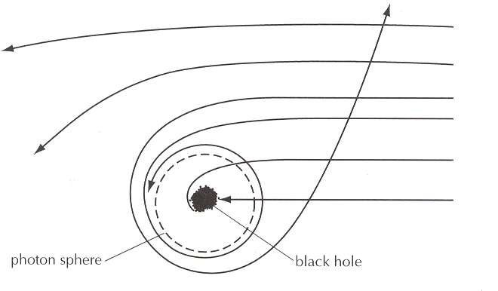
Orbits
Consider the simple cases of circular orbits, again using the equation of motion
$$F^{r}=U^{t}⁢\left(\frac{∂P^{r}}{∂t}+{Γ^{r}}_{μt}⁢P^{μ}\right)+U^{r}⁢\left(\frac{∂P^{r}}{∂r}+{Γ^{r}}_{μr}⁢P^{μ}\right)+U^{θ}⁢\left(\frac{∂P^{r}}{∂θ}+{Γ^{r}}_{μθ}⁢P^{μ}\right)+U^{φ}⁢\left(\frac{∂P^{r}}{∂φ}+{Γ^{r}}_{μϕ}⁢P^{μ}\right)$$
With some further reduction…
$$U^{t}⁢{Γ^{r}}_{tt}⁢P^{t}+U^{φ}⁢{Γ^{r}}_{ϕϕ}⁢P^{μ}=0→{\left(U^{t}\right)}^{2}⁢{g^{r}}^{r}⁢\left(\frac{−1}{2}⁢\frac{∂g_{tt}}{∂r}\right)={\left(U^{φ}\right)}^{2}⁢{g^{r}}^{r}⁢\left(\frac{1}{2}⁢\frac{∂g_{ϕϕ}}{∂r}\right)$$
We find that the orbital velocity in general is
$$V^{\hat{φ}}=\sqrt{\frac{G⁢M}{r−r_{s}}}$$

Slide 24
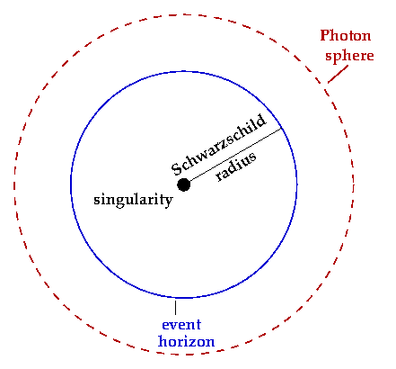
Photon Orbits
To find the orbital radius of photons, lets consider $V^{\hat{φ}}=\sqrt{\frac{G⁢M}{r−r_{s}}}=c$ case
This gives us $r_{ph}=\frac{3}{2}⁢r_{s}$
i.e. for photons, the only place they can orbit the BH is at this radius.
However, we’ll see later in a more general formulism (in Schutz) that this orbit is nowhere stable, if we accidently kick the photon a bit, it will either spiral into the BH or spiral out to infinity.

Slide 25
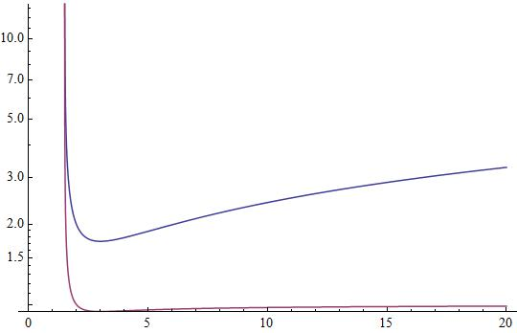
Finite mass particle orbits
For finite mass particles, we need to consider $V^{\hat{φ}}=\sqrt{\frac{G⁢M}{r−r_{s}}}<c$ case
By definition of the Lorentz factor $γ_{orb}=\frac{1}{\sqrt{1−{\left(\frac{V_{orb}}{c}\right)}^{2}}}=\sqrt{\frac{r−r_{s}}{r−\frac{3}{2}⁢r_{s}}}$
Solving for the energy and angular momentum,
$$L=p_{φ}=γ⁢m_{0}⁢V^{\hat{φ}}⁢r⁢sinθ$$
$$E=−p_{t}=\sqrt{1−\frac{r_{s}}{r}}⁢γ⁢m_{0}⁢c^{2}$$
$$L_{orb}=\sqrt{\frac{r_{s}}{2⁢r−3⁢r_{s}}}⁢r⁢m_{0}⁢c^{2}$$
$1.5 r_{s}$ -- The radius at which
$$E_{orb}=\frac{r−r_{s}}{\sqrt{r⁢\left(r−\frac{3}{2}⁢r_{s}\right)}}⁢m_{0}⁢c^{2}$$
Minimum point at $3 r_{s}$
L
E

Slide 26
The ISCO
$$L_{orb}=\sqrt{\frac{r_{s}}{2⁢r−3⁢r_{s}}}⁢r⁢m_{0}⁢c^{2}$$
$$E_{orb}=\frac{r−r_{s}}{\sqrt{r⁢\left(r−\frac{3}{2}⁢r_{s}\right)}}⁢m_{0}⁢c^{2}$$
The minimum for both of these two curves happen at $r=3r_{s}$
This is commonly called the Innermost stable circular orbit for reasons we will see later.
At this radius, L and E are
$1.5 r_{s}$ – The radius at which photons orbit
$$L=\sqrt{3}⁢r_{s}⁢m_{0}⁢c$$
$$E=\frac{2⁢\sqrt{2}}{3}⁢m_{0}⁢c$$
However, we will also find that the ISCO is more or less a ‘marginally stable’ orbit! If we accidently kick it a bit toward the black hole, it will just give up and fall in!
Minimum point at $3 r_{s}$
L
E

Slide 27
General discussion for particle motion
Previously, we have already found that we can calculate either free-fall or orbits by considering E or L respectively.
For a general consideration, it is more convenient if we write both of them in the same equation so we can discuss different the properties of the different orbits more clearly
$$P^{2}=−{m_{0}}^{2}c^{2}=g_{tt}⁢{\left(P^{t}\right)}^{2}+g_{rr}⁢{\left(P^{r}\right)}^{2}+g_{θθ}⁢{\left(P^{θ}\right)}^{2}+g_{ϕϕ}⁢{\left(P^{φ}\right)}^{2}$$
$$E=−p_{t}=\sqrt{1−\frac{r_{s}}{r}}⁢γ⁢m_{0}⁢c^{2}$$
$$L=p_{φ}=γ⁢m_{0}⁢V^{\hat{φ}}⁢r⁢$$
For simplicity, we take $θ=π/2$, so $P^{θ}=0$
$$−\frac{1}{c^{2}}⁢\frac{1}{\left(1−\frac{r_{s}}{r}\right)}⁢E^{2}+\frac{1}{\left(1−\frac{r_{s}}{r}\right)}⁢{m_{0}}^{2}⁢{\left(\frac{dr}{dτ}\right)}^{2}+\frac{L^{2}}{r^{2}}=−{m_{0}}^{2}⁢c^{2}$$
$${\left(\frac{dr}{c⁢dτ}\right)}^{2}={\left(\frac{E}{m_{0}⁢c^{2}}\right)}^{2}−\left(1−\frac{r_{s}}{r}\right)⁢\left(1+\frac{1}{r^{2}}⁢{\left(\frac{L}{m_{0}⁢c}\right)}^{2}\right)$$

Slide 28
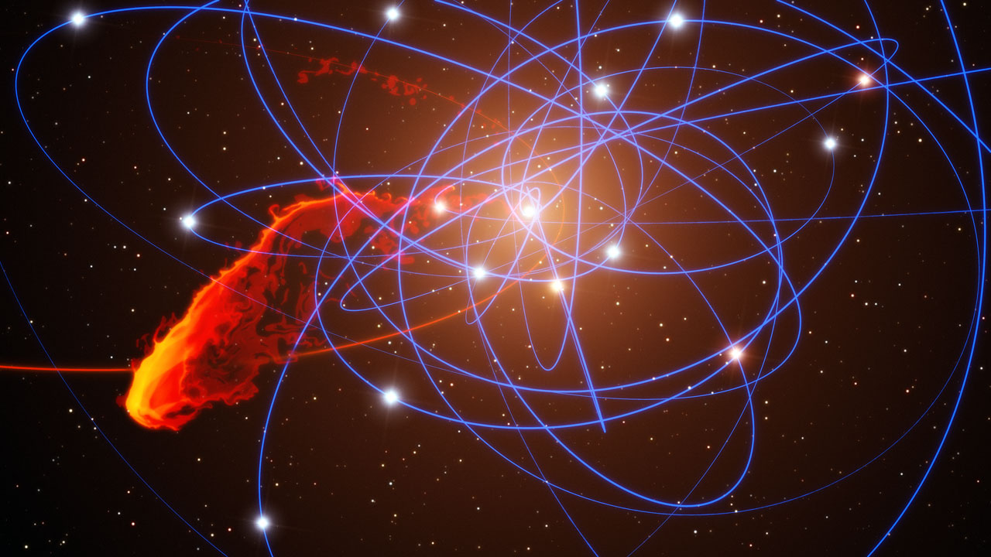
General discussion for particle motion
$${\left(\frac{dr}{c⁢dτ}\right)}^{2}={\left(\frac{E}{m_{0}⁢c^{2}}\right)}^{2}−\left(1−\frac{r_{s}}{r}\right)⁢\left(1+\frac{1}{r^{2}}⁢{\left(\frac{L}{m_{0}⁢c}\right)}^{2}\right)$$
Remember that both E and L are constant of trajectory
We can define the effective potential as $V^{2}⁢\left(r\right)≡\left(1−\frac{r_{s}}{r}\right)⁢\left(1+\frac{1}{r^{2}}⁢{\left(\frac{L}{m_{0}⁢c}\right)}^{2}\right)$
Then, ${\left(\frac{dr}{c⁢dτ}\right)}^{2}={\left(\frac{E}{m_{0}⁢c^{2}}\right)}^{2}−V^{2}⁢\left(r\right)$ very much like the classical $E_{k}=E_{tot}−V$！

Slide 29
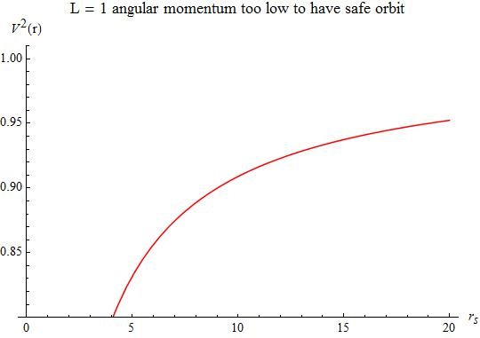
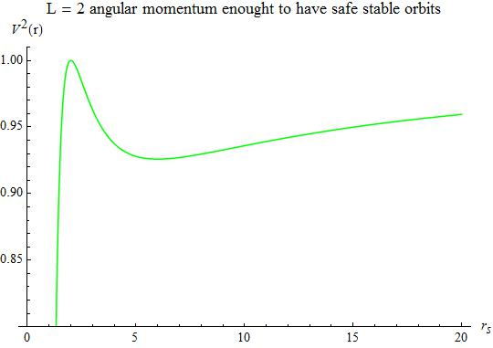
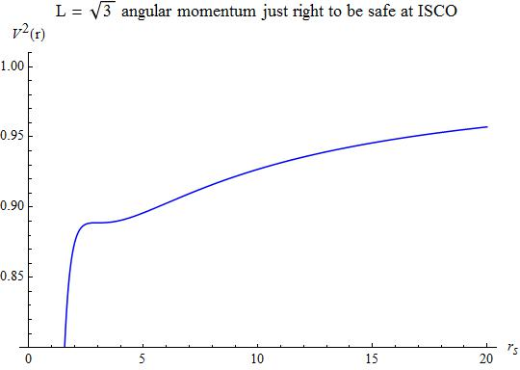
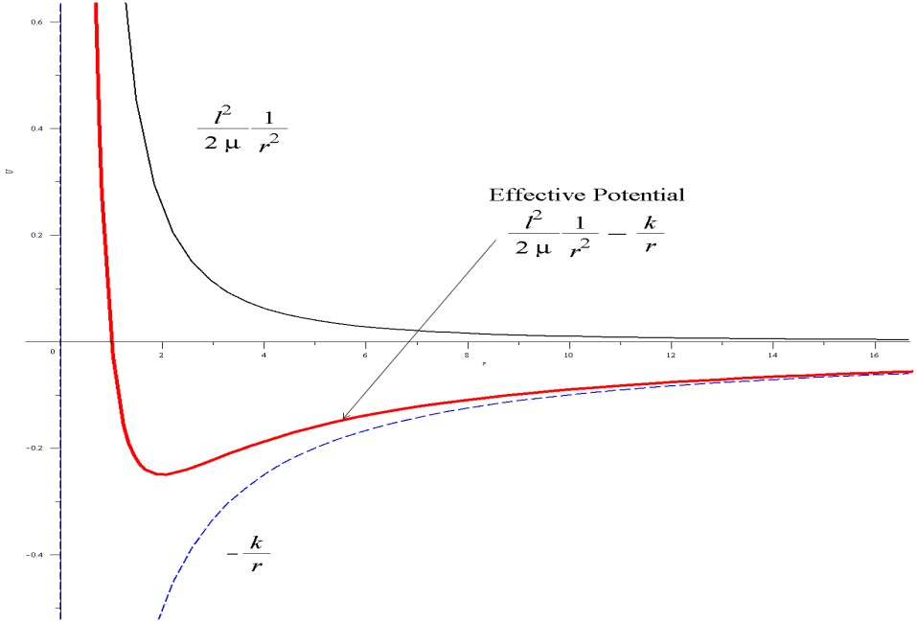
Behavior in different potentials $V^{2}⁢\left(r\right)≡\left(1−\frac{r_{s}}{r}\right)⁢\left(1+\frac{1}{r^{2}}⁢{\left(\frac{L}{m_{0}⁢c}\right)}^{2}\right)$
Unstable Circular
Capture
Hyperbolic
Capture
Elliptical
Stable Circular
Falls in no matter what! Simply put, the centrifugal force can’t balance with gravity!
${\left(\frac{dr}{c⁢dτ}\right)}^{2}={\left(\frac{E}{m_{0}⁢c^{2}}\right)}^{2}−V^{2}⁢\left(r\right)$
Comparing with Classical Physics
Capture
Circular
Double root solution
http://www2.warwick.ac.uk/fac/sci/physics/current/teach/module_home/px436/notes/lecture16.pdf

Slide 30
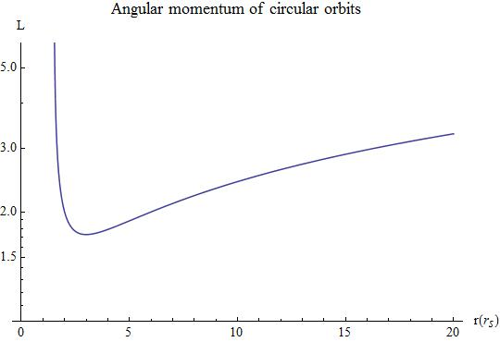
In relation to our previous analysis
For$L>\sqrt{3}⁢⁢ r_{s}m_{0}⁢c$we have two solutions.
Unstable Circular
Capture
Two solutions
Stable Circular
ISCO case
No real solution
Capture
Capture
1 Circular orbit solution

Slide 31
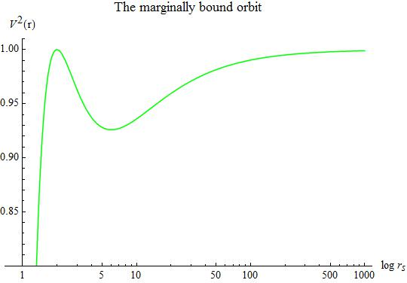
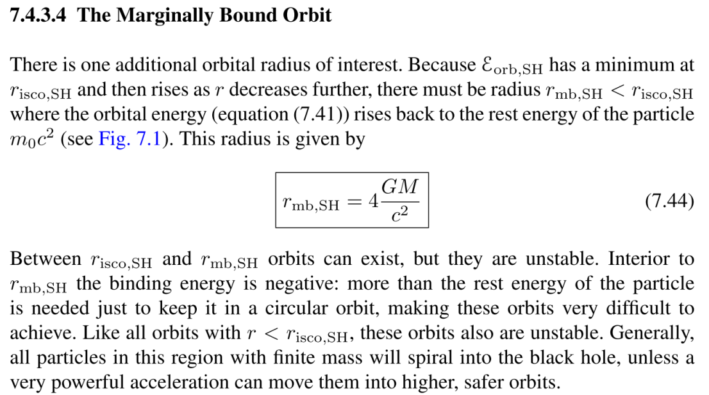
The marginally bound orbit
$$E_{∞}=E=m_{0}⁢c^{2}$$
$$2r_{s}$$

Slide 32
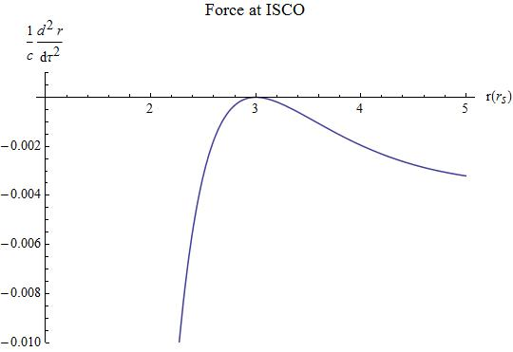
How stable is the ISCO?
$${\left(\frac{dr}{c⁢dτ}\right)}^{2}={\left(\frac{E}{m_{0}⁢c^{2}}\right)}^{2}−\left(1−\frac{r_{s}}{r}\right)⁢\left(1+\frac{1}{r^{2}}⁢{\left(\frac{L}{m_{0}⁢c}\right)}^{2}\right)$$
Taking the derivating w.r.t proper time on both sides, we get the force equation $\frac{1}{c}⁢\frac{d^{2}⁢r}{{dτ}^{2}}=−\frac{1}{2}⁢\left.\frac{d}{dr}[\left(1−\frac{r_{s}}{r}\right)⁢\left(1+\frac{1}{r^{2}}⁢{\left(\frac{L}{m_{0}⁢c}\right)}^{2}\right)\right]$ which is analogous to $\frac{d^{2}⁢\overset{⇀}{r}}{{dt}^{2}}=\frac{\overset{⇀}{F}}{m}=−\overset{⇀}{∇}V$ in Classical Physics.
Capture
1 Circular orbit solution
The ISCO is the double root solution, it is at the same time the stable and unstable circular orbit. Unfortunately for particles flying about the black hole, the result is simply that it is unstable! Any perturbation toward the black hole and the particle would have to say goodbye to the rest of the outside universe!

Slide 33
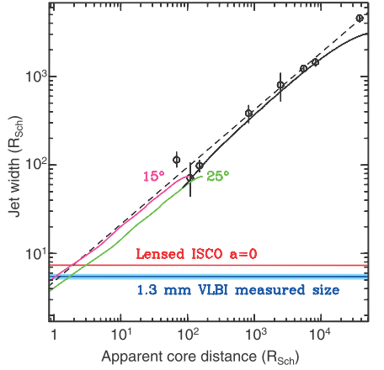
Observational evidence of the ISCO?
Resolving the Jet-Launch Region of the M87 Supermassive Black Hole ,
Science 338, 355 (2012)

Slide 34
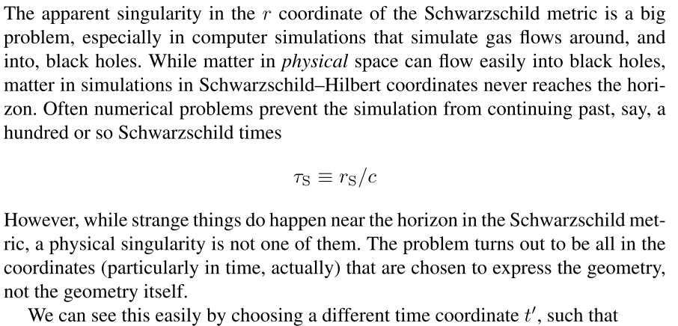
$${\left(g_{HP}^{Sch}\right)}_{αβ}=\left(\begin{matrix}−c^{2}⁢\left(1−\frac{r_{s}}{r}\right) & \frac{r_{s}}{r}⁢c & 0 & 0 \\ \frac{r_{s}}{r}⁢c & 1+\frac{r_{s}}{r} & 0 & 0 \\ 0 & 0 & r^{2} & 0 \\ 0 & 0 & 0 & r^{2}⁢\sin^{2}⁢θ\end{matrix}\right)$$

Slide 35
The Horizon-Penetrating coordinates
$${\left(g_{SH}^{Sch}\right)}_{αβ}=\left(\begin{matrix}−c^{2}⁢\left(1−\frac{r_{s}}{r}\right) & 0 & 0 & 0 \\ 0 & \frac{1}{\left(1−\frac{r_{s}}{r}\right)} & 0 & 0 \\ 0 & 0 & r^{2} & 0 \\ 0 & 0 & 0 & r^{2}⁢\sin^{2}⁢θ\end{matrix}\right)$$
$$dt′=dt+\frac{r_{s}}{c⁢\left(r−r_{s}\right)}⁢dr$$
$${Λ^{HP⁢\left(α′\right)}}_{SH⁢\left(α\right)}≡\left(\begin{matrix}1 & \frac{r_{s}}{c⁢\left(r−r_{s}\right)} \\ 0 & 1\end{matrix}\right)$$
$${\left(g_{HP}^{Sch}\right)}_{αβ}=\left(\begin{matrix}−c^{2}⁢\left(1−\frac{r_{s}}{r}\right) & \frac{r_{s}}{r}⁢c & 0 & 0 \\ \frac{r_{s}}{r}⁢c & 1+\frac{r_{s}}{r} & 0 & 0 \\ 0 & 0 & r^{2} & 0 \\ 0 & 0 & 0 & r^{2}⁢\sin^{2}⁢θ\end{matrix}\right)$$
$${Λ^{HP⁢\left(α′\right)}}_{SH⁢\left(α\right)}⁢{Λ^{HP⁢\left(β^{′}\right)}}_{SH⁢\left(β\right)}⁢{\left(g_{HP}^{Sch}\right)}_{α^{′}⁢β^{′}}={\left(g_{SH}^{Sch}\right)}_{αβ}$$
$${\left(\begin{matrix}1 & \frac{r_{s}}{c⁢\left(r−r_{s}\right)} \\ 0 & 1\end{matrix}\right)}^{T}.\left(\begin{matrix}−c^{2}⁢\left(1−\frac{r_{s}}{r}\right) & \frac{r_{s}}{r}⁢c \\ \frac{r_{s}}{r}⁢c & 1+\frac{r_{s}}{r}\end{matrix}\right).\left(\begin{matrix}1 & \frac{r_{s}}{c⁢\left(r−r_{s}\right)} \\ 0 & 1\end{matrix}\right)=\left(\begin{matrix}−\frac{c^{2}⁢\left(r−r_{s}\right)}{r} & 0 \\ 0 & \frac{r}{r−r_{s}}\end{matrix}\right)$$

Slide 36
